Slide 1
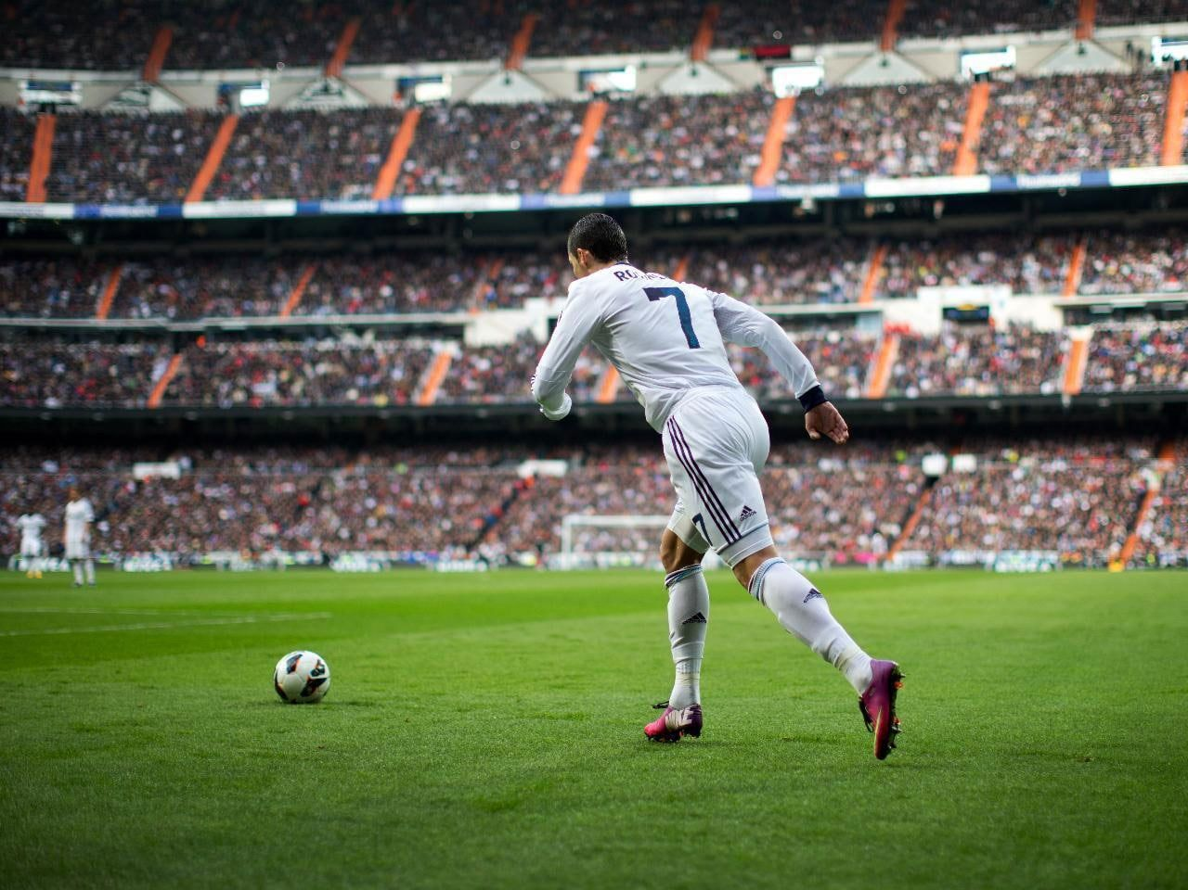
Ronaldo

Slide 2
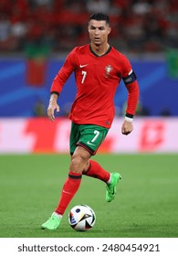
Cristiano Ronaldo: Career Highlights
Five Ballon d'Or awards, a record shared with Lionel Messi.
Champions League titles with Manchester United and Real Madrid.
Multiple league titles across England, Spain, and Italy.
All-time leading scorer for Portugal's national team.
Considered one of the greatest footballers of all time.

Slide 3
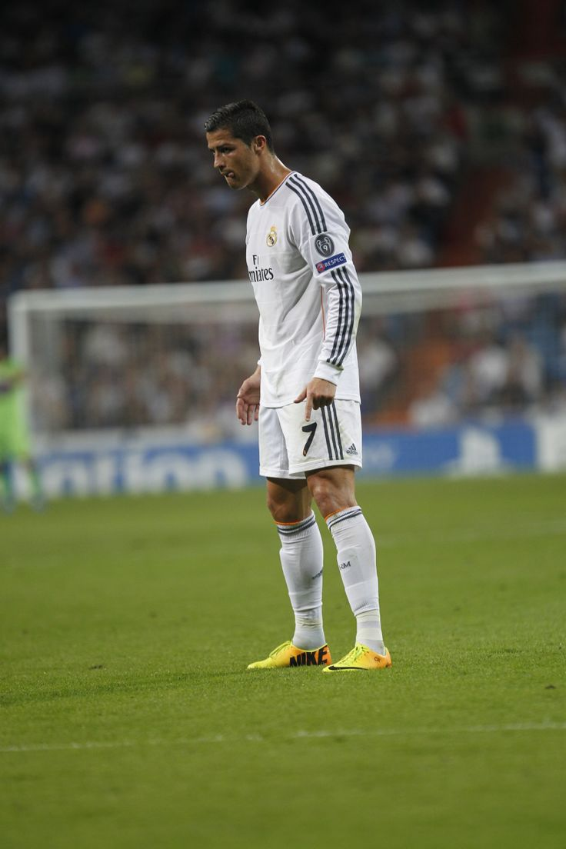
Ronaldo: Beyond the Pitch
Global brand ambassador for numerous companies.
Philanthropic work through his CR7 Foundation.
Massive social media following, influencing millions.
Entrepreneurial ventures in fashion and hotels.
A global icon transcending the sport of football.

